Slide 1




LNG Plant Proposal
by IMP Greens

Slide 2

CONTENTS
1. Introduction
2. Understanding LNG
3. LNG Value Chain
4. Benefits of LNG
5. Market Potential
6. Conclusion

Slide 3
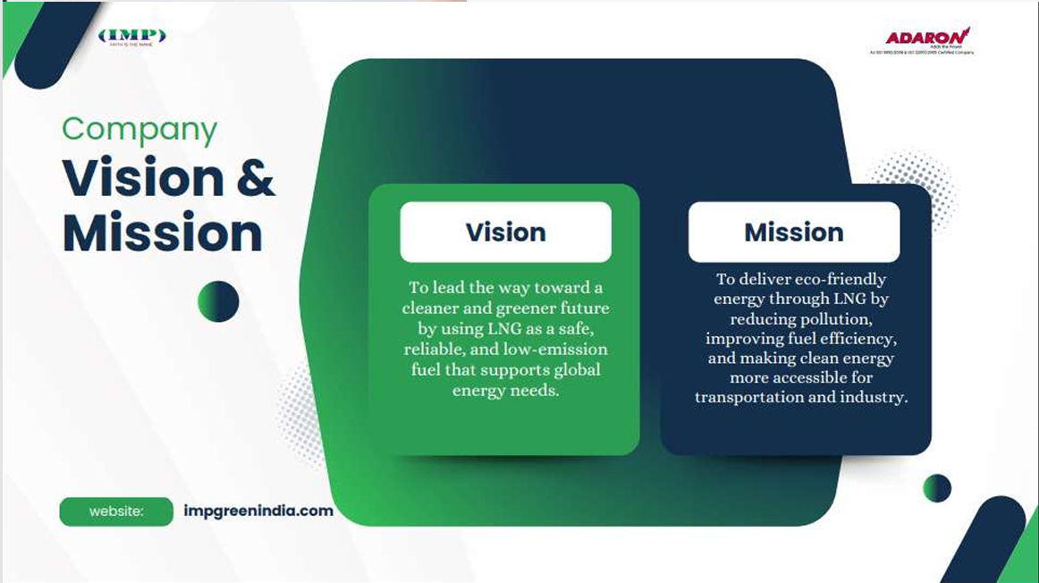

Slide 4

01
Introduction

Slide 5


About IMP India
IMP India is a New Delhi-based organization dedicated to advancing renewable energy solutions and reducing pollution.
IMP India is an Organization established with the principal aim of tapping and developing the renewable energy sources market and making the world a better place to live in with less pollution.
IMP India was formed by a group of professionals Engineers and project Managers to redefine manufacturing and distribution of alternate energy solution which specializes in Bio-CBG / CNG, Bio-Diesel and Ethanol and its value added by products.

Slide 6


Core Services & Products
1
Pump Setups: Specializing in the installation and maintenance of pump systems.
2
LNG Conversion: Offering services to convert systems to Liquefied Natural Gas, promoting cleaner fuel usage.
3
Diesel Conversion Funding: Providing financial solutions for transitioning from diesel to more sustainable energy sources.

Slide 7

02
Understanding LNG

Slide 8
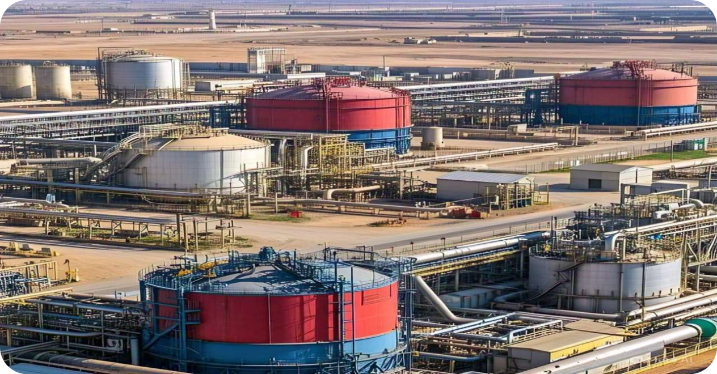
Definition of LNG
LNG is primarily composed of methane (CH₄), with smaller amounts of other hydrocarbons such as ethane (C₂H₆), propane (C₃H₈), and butane (C₄H₁₀).
The liquefaction process involves cooling natural gas to approximately –162°C (–260°F), which reduces its volume by about 600 times compared to its gaseous state.

Slide 9

Physical and Chemical Properties
1
Boiling Point: Approximately –162°C (–259°F).
2
Freezing Point: Around –182°C (–296°F).
3
Specific Gravity (liquid): Ranges from 0.415 to 0.45 at –162°C.
4
Vapor Specific Gravity: Between 0.55 and 1.0.
5
Flammability Limits in Air: Methane, the primary component, has flammability limits between 5% and 15% by volume.
6
Appearance: Colorless and odorless.
7
Toxicity: Non-toxic and non-corrosive.

Slide 10

Storage and Transportation
Due to its significantly reduced volume when liquefied, LNG is efficiently stored and transported in specialized cryogenic tanks at near atmospheric pressure.
This makes it feasible to transport natural gas over long distances, especially to regions not connected by pipelines.

Slide 11

Safety Considerations
While LNG is non-toxic and non-corrosive, it poses certain hazards:
•Cryogenic Burns: Direct contact can cause severe cold burns.
•Asphyxiation: In confined spaces, LNG vapors can displace oxygen, leading to asphyxiation risks.
•Flammability: When vaporized and mixed with air within its flammable range, it can ignite if exposed to an ignition source.

Slide 12




Environmental Impact
However, the processes of liquefaction, transportation, and regasification consume energy and can contribute to greenhouse gas emissions.
LNG is considered a cleaner-burning fossil fuel compared to coal and oil, emitting fewer pollutants and greenhouse gases.
Additionally, methane leaks during production and transportation can offset some of the environmental benefits.
2
1
3

Slide 13

03
LNG Value Chain

Slide 14

LNG Value Chain
Overview of the LNG Value Chain

Slide 15


Overview of the LNG Value Chain
Exploration, Production, Liquefaction, Transportation, Regasification, and Distribution

Slide 16



Exploration and Production (Upstream)
Advanced geological surveys and drilling techniques are employed to locate and access these reserves.
2
The process begins with the identification and extraction of natural gas from underground reservoirs.
1
Once extracted, the raw natural gas is transported via gathering pipelines to processing facilities where impurities such as water vapor, hydrogen sulfide, carbon dioxide, and other hydrocarbons are removed.
3

Slide 17


Liquefaction (Midstream)
In this stage, the purified natural gas is cooled to approximately –162°C (–260°F), transforming it into a liquid state—LNG.
This process reduces the gas's volume by about 600 times, making it more economical to store and transport over long distances.
Liquefaction facilities are typically located near production sites or coastal areas to facilitate easy access to shipping routes.

Slide 18



Transportation
These tankers transport LNG across oceans to markets where pipeline infrastructure may be unavailable or impractical.
2
Once liquefied, LNG is loaded into specialized cryogenic tankers designed to maintain the low temperatures required to keep the gas in its liquid form.
1
The design of these vessels ensures minimal heat ingress, preserving the LNG's liquid state during transit.
3

Slide 19




Regasification
Upon reaching its destination, LNG is offloaded at regasification terminals.
Here, the LNG is warmed and converted back into its gaseous state using heat exchangers.
1
2
Some regasification terminals are land-based, while others are floating storage and regasification units (FSRUs) anchored offshore.
The regasified natural gas is then introduced into the local pipeline network for distribution to end-users.
4
3

Slide 20



Distribution (Downstream)
The final stage involves delivering the natural gas to various consumers, including residential, commercial, and industrial users.
The gas is transported through an extensive network of pipelines and, in some cases, via trucks for areas not connected to the pipeline infrastructure.
End-users utilize natural gas for heating, electricity generation, cooking, and as a feedstock for chemical production.

Slide 21

04
Benefits of LNG

Slide 22







Why LNG as a fuel?
Safer Fuel: Non-toxic, non-corrosive and non-carcinogenic fuel that does not pollute water. Lighter than air (quickly dissipates) and has a High auto-ignition temperature (537°C)
2
Clean Fuel: Purest form of Natural Gas with no traces of Sulphur, Water, Dust
1
3
High Calorific Value: Compared to diesel, propane, FO etc.
Economic Fuel: LNG is cheaper than LPG, Propane & Diesel. Can even replace FO in nearby areas to Terminals
5
4
Saving of Forex: LNG is cheaper than crude at import point in eq. energy terms

Slide 23

05
Market Potential

Slide 24

Target Market Segments for LNG(1)
Small Industrial Consumers
Industries not connected to the natural gas pipeline network.
LNG provides a flexible, cleaner, and transportable fuel alternative.
Automotive Sector
LNG as an automotive fuel.
Development of LNG dispensing stations along Indian highways to support heavy-duty vehicles and fleets.

Slide 25
Target Market Segments for LNG(2)
Specialized Industrial Consumers
Industries requiring constant flame temperature, such as:
•Glass manufacturing
•Ceramic tile production
LNG ensures precision and efficiency in these high-temperature applications.
City Gas Distribution (CGD) Companies
Interim LNG supply solution for CGD companies awaiting pipeline connectivity.
Enables early market access before trunk pipeline infrastructure is in place.

Slide 26
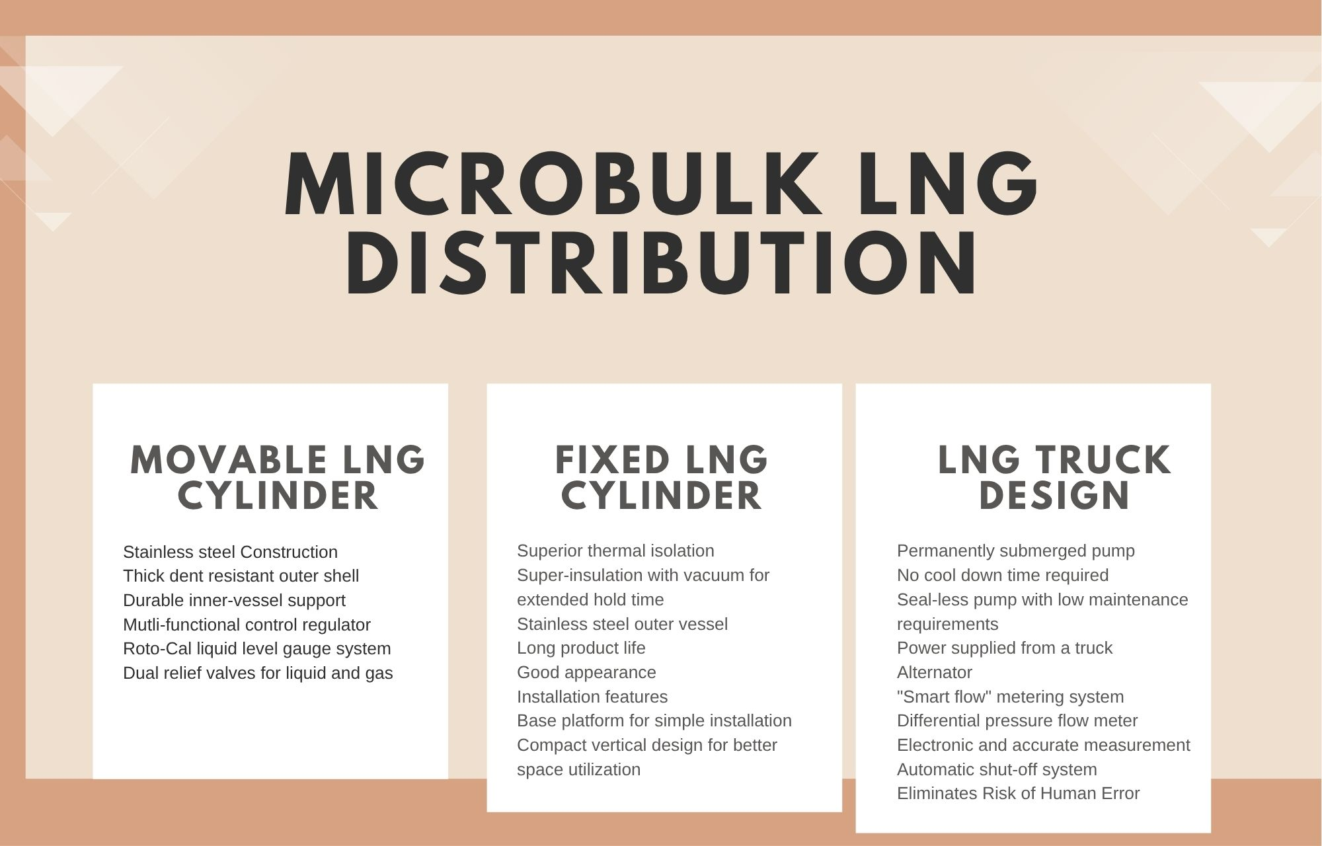

Slide 27
Particulars | Total Cost | Time Period
Equipment installation, engineering, design, commissioning of Plant with inter pipeline | Rs. 3.5 Cr | 5-6 Months
Storage Tank and loading & uploading pump system & 1 unit LNG Dispenser | Rs. 2.5 Cr | -
Construction and Development expenditure on land including civil works | Rs. 1.25-1.5 Cr | -
Land Acquisition Cost | Rs. XX Cr | -
Power connection & Power Backup, DG Gensets, Permissions and Miscellaneous cost | Rs. O.25 Cr | 3 Months
Total Cost of Station | Rs. 7.75 Cr | 9-12 Months
Plant Installed Capacity
LNG Storage Capacity: 56KL
LNG Cylinder Filling Capacity: 175-350 LPM

Slide 28
REVENUE PROJECTION
FINANCIAL ANALYSIS
Area Office | Noida AO
Market Penetration % in 5 years in Delhi Ncr | 10%
Potential sale of LNG per month (in Lit) | 750 KL
Potential sale of LNG per day (in Lit) | 25000
Profit to R.0 per month (in Lakhs) | 35-40

Slide 29
FUEL COST ANALYSIS AND SAVINGS ON DIESEL TO LNG VEHICLES
Vehicle details | Tata Lpt 2518- diesel | Tata Lpt 2518 D2LNG
Engine model | Cummin GBT 5.9 | Cummin NG Mod to LNG
Fuel used | Diesel | LNG
Fuel Unit | Litres | Kg/ Litres
Fuel price /Unit (INR) | 92 | 60
Vehicle mileage Km/Unit | 3.20 | 3.50
Fuel consumption Unit/100 km | 31.25 | 28.60
Cost( in INR) to run 100 km | 2875 | 1714
Cost per km(INR) | 28.75 | 17.14

Slide 30
Fuel Savings LNG Over Diesel is 40.4% (Approx) Payback Calculations
Km | 300 | 400 | 500
Saving in Rs per Day | 3483 | 4644 | 5805
Saving in Rs per Month | 1,04,490 | 1,39,320 | 1,74,150
Saving in Rs per Year | 12,53,880 | 16,71840 | 20,89,800
Cost of Retro Fitments (LNG) | 13.85 Lakh | - | -
Payback period | 13 Month | 10 Month | 8 Month

Slide 31

Contact Information
IMP Green India
www.impgreenindia.com
E-24, First Floor, Noida Sector-3, Gautam Buddha Nagar, Bharat, 201301
No. 98188 35388

